Slide 1
Observing & Communicating Observations of Nature
University Library
Naturalists of the Past in ISU Library’s Digital Collections

Slide 2
George Washington Carver
University Library

Slide 3
Carver Describing a Cercosporas
8 -28-1899
My dear Prof. Pammel,
Your esteemed favor of Aug. 17th at hand and contents duely noted. You will find some very interesting Cercosporas among these, you may find in some cases that you will have some difficulty in determining of finding them, as they do not make spots but are confluent over the surface some are situated on the upper side and others are the underside of the leaf. They seem to be in some cases facultative in others true parasites, and in still others true sap.[robes] the sap. spread over the surface, the spores are abnormally long and quite hyaline the one on Hibiscus esculentus is an example the more I study this one the more convinced I become that it does not differ much if any from that on Gossypium. I regret in Iowa cases the material was very scarce and I could not send you more. I am sending you the
University Library
Notes:
Where might he have found the fungus? Specific search? In his own garden?
Fungus: feeds on organic matter (includes molds, yeasts, mushrooms)
Confluent: flowing together; merging
“Sap.” = saprobe (probably). Fungus exists on dead cells of the leaves, not causing a fungal disease. Therefore not a parasite, which Carver mentions elsewhere in the letter.

Slide 4
Carver Describing a Cercosporas (p.2)
best I could to determine them correctly with the limited means I have at my command.
My paper I think will be more useful as published in your Bien. Rept. than in the Acad. of Science Rept. as it will have a wider distribution.
Thank you for Miss Cales kindly remembrance. I find this group of Cer. a very interesting one indeed.
With best wishes to all.
Geo. W. Carver
University Library

Slide 5
Image of Cercospora on a Beach Morning Glory Leaf
University Library
Notes:
Ask: Type Carver described?

Slide 6
Carver Specimen sent to Pammel Collected August 17, 1899
University Library

Slide 7
Ada Hayden & Prairie Documentation
University Library

Slide 8
Ada Hayden Lantern Slide: Field Bordering Lost Island Lake (NW Iowa)
University Library
Notes:
Hand colored

Slide 9
Ada Hayden: Botanical Drawings of Oak Trees in Winter
University Library
Notes:
Detail

Slide 10
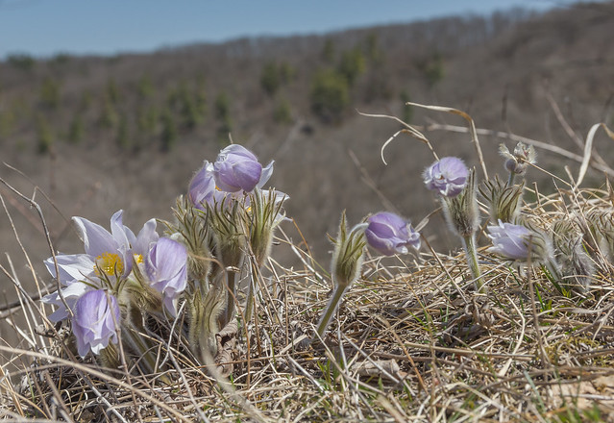
Ada Hayden: Radio Talk Description of a Prairie July 3, 1946
…Now for the story of the prairies as our ancestors saw it. In the early days on spring when the last snowbank had melted away from the reddish-brown grassland, many lavender pasque flowers lent a bluish cast to gravelly knolls of the rolling northern prairies. When our grandparents saw these flowers, they knew that winter had ended. Throughout the summer season--the growing season, that is--this prairie exhibited constant change. On a breezy July day, waving grasses rhythmically rose and fell with the wind. On a still day, the pioneers looked out across a prairie that resembled a mosaic pattern because of the spots of various shades of green. These spots marked the boundaries of different types of vegetation. And throughout the season a changing panorama of rainbow-hued flowers colored the grassland…
Blufftop Pasqueflowers" by Brett Whaley is licensed under CC BY-NC 2.0
University Library

Slide 11
Charles Christopher Parry: Gila Survey Field Notebook (September 1849 to February 1850) Description of Mesquite
University Library

Slide 12
Charles Christopher Parry: Gila Survey Field Notebook Description of Mesquite - Translation
This characteristic tree is found on all the elevated sandy planes, and river bottoms west of the Cordilleras. It varies in character according to the nature of the soil. On the more elevated sandy plains being of a shruby character its procumbent branches collecting the drifting sand in hillocks fortified on all sides with their thorny branches. On bottom soil it acquires the character of a sizable tree * generally[?] sending off radiate branching hunks, which spreading with their outside stray close to the ground make an impenetrable chapperal to all but hungry mules. The larger trunks by age acquire a shaggy bark – the wood has a large proportion of walnut colored heart wood and is durable, but from its habit of growth seldom affording sticks useful for farming or other purposes. It gives excellent fuel…
University Library
Notes:
Procumbent:
Chapperal: dense growth of shrubs or trees

Slide 13
Mesquite
"Honey Mesquite" by K Schneider is licensed under CC BY-NC 2.0
University Library

Slide 14
Questions?
University Library

